Slide 1




BitTorrent v.1.0 and BEP Enhancements
Scott Felch
Spring 2015
CSCI 467

Slide 2

What is BitTorrent?
It is a P2P file distribution protocol designed to replace FTP for large file transfers.
Written by Bram Cohen in 2001 in his pajamas on the couch after work while watching Friends.

Slide 3


Some fun facts
BitTorrent currently accounts for 25% of all internet traffic.
Share decreased down from 33% a few years ago as video streaming has become more prevalent.
In 2014 BitTorrent was overtaken by Netflix in total aggregate bandwidth usage.

Slide 4
What’s this presentation about?
The original version of BitTorrent Protocol, known as BTP/1.0.
The BitTorrent Enhancement Proposal process used for building on existing codebase to add new functionality.
Efforts to decentralize the swarm through trackerless torrents by utilizing magnet links and Dynamic Hash Tables (DHTs).

Slide 5
Useful terms
torrent: a file or group of files downloaded using the BitTorrent protocol
tracker: server that facilitates communication of information and data between peers
swarm: the group of peers connected to a torrent
peer: a user connected to a torrent
leech: a user downloading the file
seed: a user done downloading and purely uploading
metainfo: information about the files in the data payload, or communication over the network

Slide 6

Where do torrents come from?
An uploader will use a torrent client to create a .torrent metainfo file about a file(s) they wish to torrent.
The metainfo file must be hosted on:
a webserver so that clients can access them through the browser for initial connection
a tracker so that clients can communicate with each other continuously thereafter
When a user downloads the metainfo file and opens it with their client, the server will connect them to other users in the swarm.
The original uploader serves as the first seed in the swarm.

Slide 7
What’s in the metainfo file?
Metafile utilizes a form of data structure flattening called bencoding (pronounced “bee encoding”), invented by Bram and named after himself.
Flattened data example:
String: [str_len]:[str]
Ex: 8:announce
evaluates to announce
Integer: i[int]e
Ex: i420e
evaluates to 420
Dictionary: d[key]:[value][key]:[value]e
Ex: d5:monthi4e4:name5:aprile
evaluates to {‘month’=>’4’,’name’=>’april’}

Slide 8

Dictionaries within dictionaries
{‘announce’ => [url of tracker] }
{‘info’ =>
{‘name’ => [suggested filename for data payload],
‘piece_length’ => [size of pieces in torrent in bytes],
‘pieces’ => [string holding SHA1 hashes of files],
SINGLE FILE TORRENTS:
‘length’ => [filesize in bytes],
MULTI FILE TORRENTS:
‘files’ =>
{ [dir_name] => [subdirectory structure...] }
} }

Slide 9
Protocols within protocols
Tracker HTTP Protocol (THP)
Utilizes HTTP GET requests to communicate with client to add them to the swarm, monitor statistics, and connect peers.
Peer Wire Protocol (PWP)
Utilizes TCP-based asynchronous messaging between peers for sending updates about files had and files interested in, as well as the data payload.

Slide 10
Tracker HTTP Protocol (THP)
Client sends a HTTP GET request to the tracker URL.
Contains a bencoded dictionary containing user ID, connection type, IP address, etc
Server responds with another GET request.
Contains a bencoded dictionary containing refresh interval, complete (# of seeds), incomplete (# of leeches), and a bencoded dictionary ‘peers’ that has info of a neighborhood of peers for the client to join.
Data received from the THP connection is used to form connections with peers over PWP.

Slide 11
Peer Wire Protocol (PWP)
Used by the client for all communication and data payload delivery with peers.
Client now has an open TCP port listening for incoming connections from remote peers that have been notified of a newcomer to the swarm.
Before any payloads can be exchanged, a two-way handshake must occur. The handshake entails exchanging strings containing concatenated fields for:
‘name_length’ unsigned int indicating length of string of protocol_name
‘protocol_name’ string of current protocol name, ex: ‘BitTorrent protocol'
‘reserved’ 8 bytes saved for future utilization
‘info_hash’ 20 byte hash of ‘info’ dict for verifying data integrity
‘peer_id’ 20 byte self-assigned string for identification purposes
Payload transfer begins!

Slide 12

Bandwidth control?

Slide 13
Where do we go from here?
BitTorrent was designed with modularity in mind from the beginning.
There are reserved bits in dictionaries that were initially unused, but today are used for client-specific functionality. (Features unique to Vuze, etc.)
Modifications or additions to the BitTorrent protocol or any surrounding tools, policies or environments are handled through a formal system known as BitTorrent Enhancement Proposals (BEPs).
The BEPS system is essentially the same as the Internet Engineering Task Force’s system of doing Request For Comments (RFCs).
Visually modeled after Python’s PEP documentation style and change management process.

Slide 14
Kinds of BEPs
Standards Track: describes an extension or behavioral change of a client, tracker, or web server.
Informational Track: describes a BT design issue, discovery of new information, or suggestions of best practices. Informational-only, no action is required.
Process Track: similar to Standards Track, but regarding a policy pertaining to BT, rather than technical implementation.

Slide 15
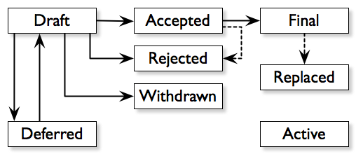

From Draft to Active
Gets vetted by:
forum members
BEP engineers
and the BDFL.
BDFL = Benevolent Dictator For Life, Bram Cohen. (self-appointed)

Slide 16
Acception and rejection standards
To be approved must:
demonstrate a clear, complete description of proposed enhancement
represent a net improvement to BT
Standards BEPs must be functional in live test swarms
Can get rejected for:
too broad/vague
duplication of functionality
serious technical flaws or infeasibility
not backwards compatible with existing standards
the BDFL doesn’t like it

Slide 17
Watch BitTorrent grow!
BEPS mean change.
Change means improvement.
Improvement means decentralization of resources.
It was through BEP0005 and BEP0009 we got magnet links, and DHT tracker-less tracking.

Slide 18
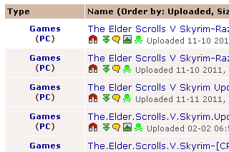
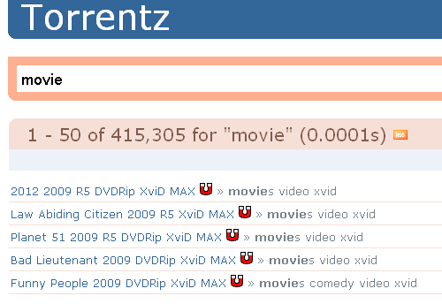

Magnet URLs offer an alternative to .torrent files
.torrent files can be up to 70KB in size with large payloads or small piece sizes.
They contain a lot of unnecessary, optional fields.
Magnet URLs must fit within 2083 characters maximum length of a URL.
Can’t fit all the data from a .torrent file, but can fit addresses of a neighborhood of peers.
Once connected to peers, the file metadata not acquired from a .torrent will be acquired from peers.
No need to swap a file, can just send a URL to someone to connect.
Unfortunately, although it can provide an initial connection, it doesn’t negate the need for a tracker running the THP service.
...until we introduce DHT!

Slide 19
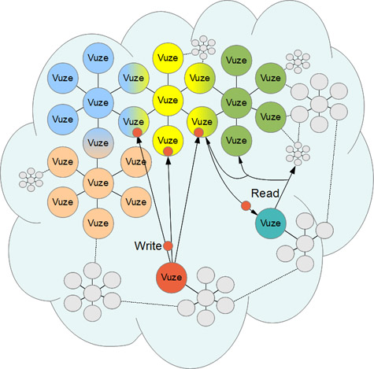
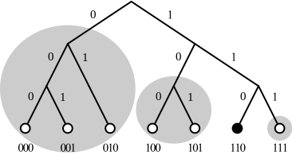
Distributed Hash Tables change EVERYTHING! (almost)
BEP0005 introduced Mainline DHT, a BitTorrent-specific utilization of the Kademilia-based DHT technology.
Generally just called “DHT” for short.

Slide 20
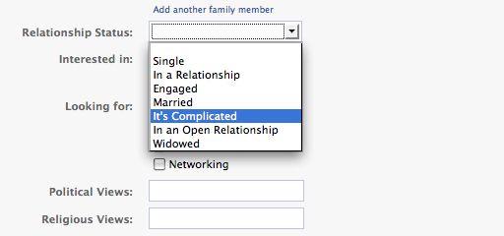
How does it work?
Sets up a second, concurrent UDP-based network connection when a user connects to a torrent. On this network a user is a ‘node’, to distinguish from ‘peer’ on PWP.
When a node wants to download a piece from the swarm, it sends a get(key) RPC request to the DHT and waits for a response containing the value of an address of a peer with that file.
Still requires centralized connection to bittorrent.org for the first client to launch the torrent, all subsequent communications are decentralized.

Slide 21

Questions?

